Slide 1
Speaking Test

Slide 2

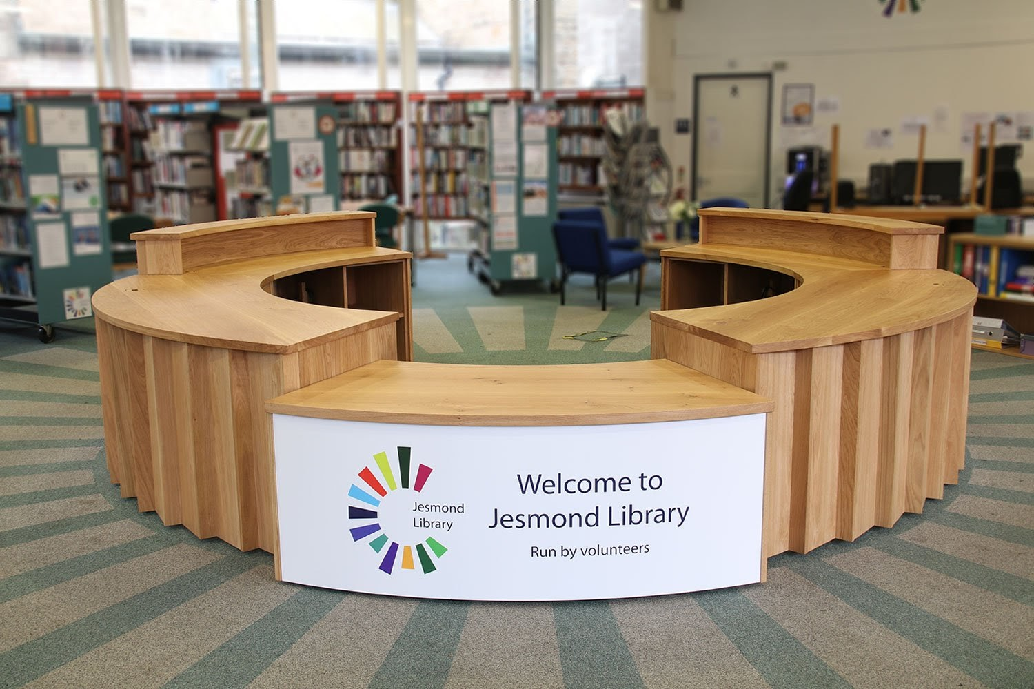
Part 1: Role play

Slide 3
Speaker A: Imagine you are looking for the book 'Modern Australian history'.
Speaker B: Imagine you are a librarian.
At the reception desk, A asks B for help to find the book.
00 : 64
00 : 61
00 : 69
00 : 67
00 : 72
00 : 75
00 : 78
00 : 81
00 : 84
00 : 90
00 : 33
00 : 28
00 : 12
00 : 03
00 : 40
00 : 35
00 : 62
00 : 53
00 : 45
00 : 44
00 : 42
00 : 08
00 : 04
00 : 07
00 : 00
00 : 16
00 : 26
00 : 65
00 : 23
00 : 58
00 : 54
00 : 41
00 : 31
00 : 25
00 : 22
00 : 15
00 : 09
00 : 57
00 : 49
00 : 46
00 : 43
00 : 39
00 : 38
00 : 36
00 : 32
00 : 24
00 : 17
00 : 13
00 : 10
00 : 02
00 : 27
00 : 11
00 : 70
00 : 59
00 : 52
00 : 51
00 : 34
00 : 29
00 : 21
00 : 56
00 : 55
00 : 50
00 : 48
00 : 47
00 : 37
00 : 20
00 : 14
00 : 06
00 : 18
00 : 01
00 : 30
00 : 19
00 : 05
00 : 73
00 : 76
00 : 79
00 : 82
00 : 85
00 : 88
00 : 63
00 : 71
00 : 60
00 : 66
00 : 68
00 : 74
00 : 77
00 : 80
00 : 83
00 : 86
00 : 89
00 : 87

Slide 4
Test 2
Speaker A: Imagine you are a librarian.
Speaker B: Imagine you borrowed the book 'Modern Australian history' but you forgot to return it, and now you have to pay late fees.
B should explain to A and ask speaker A to cancel your fees.
00 : 64
00 : 61
00 : 69
00 : 67
00 : 72
00 : 75
00 : 78
00 : 81
00 : 84
00 : 90
00 : 33
00 : 28
00 : 12
00 : 03
00 : 40
00 : 35
00 : 62
00 : 53
00 : 45
00 : 44
00 : 42
00 : 08
00 : 04
00 : 07
00 : 00
00 : 16
00 : 26
00 : 65
00 : 23
00 : 58
00 : 54
00 : 41
00 : 31
00 : 25
00 : 22
00 : 15
00 : 09
00 : 57
00 : 49
00 : 46
00 : 43
00 : 39
00 : 38
00 : 36
00 : 32
00 : 24
00 : 17
00 : 13
00 : 10
00 : 02
00 : 27
00 : 11
00 : 70
00 : 59
00 : 52
00 : 51
00 : 34
00 : 29
00 : 21
00 : 56
00 : 55
00 : 50
00 : 48
00 : 47
00 : 37
00 : 20
00 : 14
00 : 06
00 : 18
00 : 01
00 : 30
00 : 19
00 : 05
00 : 73
00 : 76
00 : 79
00 : 82
00 : 85
00 : 88
00 : 63
00 : 71
00 : 60
00 : 66
00 : 68
00 : 74
00 : 77
00 : 80
00 : 83
00 : 86
00 : 89
00 : 87

Slide 5

Part 2: Oral DCT test

Slide 6

There are 6 items in Part 2 of the task. They are 6 scenarios
that you are very likely to encounter in Australia.
In each scenario, imagine that you are studying abroad in
Melbourne, Victoria.
Imagine that you are speaking to a real person.
You will see a description on the screen, which will also be read out
loud through the recording to you. Follow along with the speaker.
When you see ‘You Say’ on the screen and hear the bell, say the
first thing that comes to your mind.
You have 10 seconds to respond. Please speak clearly.
You can not repeat the item as your response, or your answer would
be considered as invailed.

Slide 7

该项测试共有6道题，包含6种你在澳大利亚可能遇到的场景。
在每种场景下，想象你是在澳大利亚墨尔本留学的大学生，你在与一个真人进行交谈。
你将会在屏幕上看到场景描述，并会有一段录音为你念出该描述。请把注意力放在录音和场景提示上。
当你听到“叮” 的提示后，请说你脑中出现的表述。
每一题你将有10秒应答时间。请清楚地回应。
请勿照读题干，照读题干将被视为无效答案。

Slide 8

Here’s an example.
You are buying some stuff in a market, you want to buy some lamb, you want to know the price.
You say:_________________
00 : 10

Slide 9
Ready?
Begin!
▼

Slide 10
Section 1
There are 3 scenarios.
Say what you think according to the scenarios.

Slide 11

Test 1
You want to go into the classroom to attend a lecture, but there are too many people at the entrance, you can’t pass.
You say:_________________
00 : 05
00 : 04
00 : 03
00 : 08
00 : 02
00 : 10
00 : 07
00 : 01
00 : 09
00 : 06
00 : 00

Slide 12
Test 2
You are having lunch with your friend Alex. You receive a call, and you want to answer this call. You feel sorry.
You say:_________________
00 : 05
00 : 04
00 : 03
00 : 08
00 : 02
00 : 10
00 : 07
00 : 01
00 : 09
00 : 06
00 : 00

Slide 13
Test 3
Your friend Anna ask you to hang out, but you don’t want to go.
You say: ________________
00 : 05
00 : 04
00 : 03
00 : 08
00 : 02
00 : 10
00 : 07
00 : 01
00 : 09
00 : 06
00 : 00

Slide 14
Section 2
There are 3 scenarios.
Response the other people in the scenarios.

Slide 15
Test 1
You want to borrow a book ‘Harry Potter’ from your brother Peter.

Slide 16

You say:
Hey, what’s up?
00 : 05
00 : 04
00 : 03
00 : 08
00 : 02
00 : 10
00 : 07
00 : 01
00 : 09
00 : 06
00 : 00
Peter

Slide 17
Test 2
Your classmate wants to take a look at your answers in the quiz before the deadline, you don’t want to do this.

Slide 18
You say:
May I look your answers?
00 : 05
00 : 04
00 : 03
00 : 08
00 : 02
00 : 10
00 : 07
00 : 01
00 : 09
00 : 06
00 : 00
your classmate

Slide 19
Test 3
You and your best friend Jim would have dinner at 5 PM, while you are late.
You apologize to him.

Slide 20
You say:
Hey, you are finally here!
00 : 05
00 : 04
00 : 03
00 : 08
00 : 02
00 : 10
00 : 07
00 : 01
00 : 09
00 : 06
00 : 00
Jim

Slide 21
This is the end of this test.
Thank you!

